Slide 1
An LIS Solution for your Blood Culture Contamination Monitoring Requirement
Ann Hanlon
Johns Hopkins

Slide 2
Before we start!!!
What Sport is being added to the Summer Olympics for the first time since 1904?

Slide 3
GOLF!!

Slide 4
Background:

Slide 5
What is a Blood Culture?
The process of obtaining blood for culture either through a venipuncture or line draw
Usually performed to rule out bloodstream infection
Recommendation is 2 bottles—one aerobic and one anaerobic
10 ml of blood per bottle
A minimum of two blood cultures is recommended per suspected bacteremic episode

Slide 6
What is a Blood Culture Contaminant? Laboratory Definition
Organisms
Common skin bacteria are suspect
viridans streptococci
Corynebacterium sp.
Bacillus sp.
coagulase negative staphylococci
Micrococcus sp.
Propionibacterium acnes
Positive blood cultures fulfilling this criteria are “flagged” by Soft.
Bench technologists then look back at previous Blood cultures and if there are no other positive cultures with the same organism within +/- 24h of that positive result, they accept that it is a contaminant.

Slide 7
Calculation of Rates
Rates are calculated by dividing the total number of “flagged” cultures by the total number of blood cultures received from a particular location.
# of flagged blood cultures
# of blood cultures drawn

Slide 8
Blood Culture Contamination National Benchmark
College of American Pathologists—two independent prospective studies among adult inpatient units.
Median rates of contamination were 2.5% and 2.9%, respectively
National benchmark is < 3.0%
Schiffman RB et al 1998. Arch Pathol Lab Med 122:216.

Slide 9
Why Do We Care?
JCAHO/CAP requirement
Detecting the presence of bacteria in the blood is one of the most important functions in the clinical microbiology laboratory
Highly dependent on the collection technique for its sensitivity and specificity
In the study by Bates, et al (JAMA 1991;265:365) blood culture contamination lead to:
excess length of stay
an increase in laboratory charges (20% increase)
increased parenteral antibiotic charges (39% increase)
excess overall costs of approximately $4400 per contaminated culture

Slide 10
Summer Olympic Trivia #2
Who are the Mascots for the 2016 Summer Olympic Games?

Slide 11
Vinicius and Tom!
The Olympic mascot is called Vinicius and is named after musician Vinicius de Moraes. The Olympic mascot represents a mix of Brazilian wildlife with the intelligence of cats, the agility of monkeys, and the grace of birds. The Paralympic mascot is called Tom, named after the musician Tom Jobim. He represents the plants of Brazilian forests and can pull any object from his head of leaves and is always growing and overcoming obstacles.

Slide 12
SoftMic Set up

Slide 13
How Do We Set Up Soft?
In order to use the Blood Culture Contamination Report, you need to have your system set up properly so that your orders will qualify to the report.

Slide 14
4.5 has set ups in Setting/Definitions

Slide 15
BBC_HIGHLIGHT_VALUE

Slide 16
Blood Culture Media
Any media that is being used for Blood Cultures, must have the Blood Culture Flag checked in the Media Set up File.
This is extremely important!

Slide 17
In order to qualify to the TOTAL number of blood cultures for the BCC report, the order must have the following:
A media with the blood culture flag set
This media or a child media(media added from the parent blood culture media) must have the resulted flag set.

Slide 18
How to get your media to be marked as resulted and set the Resulted Media Flag:
We post media results from our Blood culture instrument and that marks the media as Resulted.
Adding media to the Blood culture media through reflex and from that media reflexing in the isolate. This will mark the child media as resulted.
Batch resulting the Blood Culture media from a Resulting Worklist.
Autoresulting mapped to the Bottle/media.
Manual selection of media linkage with automatic setting of the resulted media flag.

Slide 19
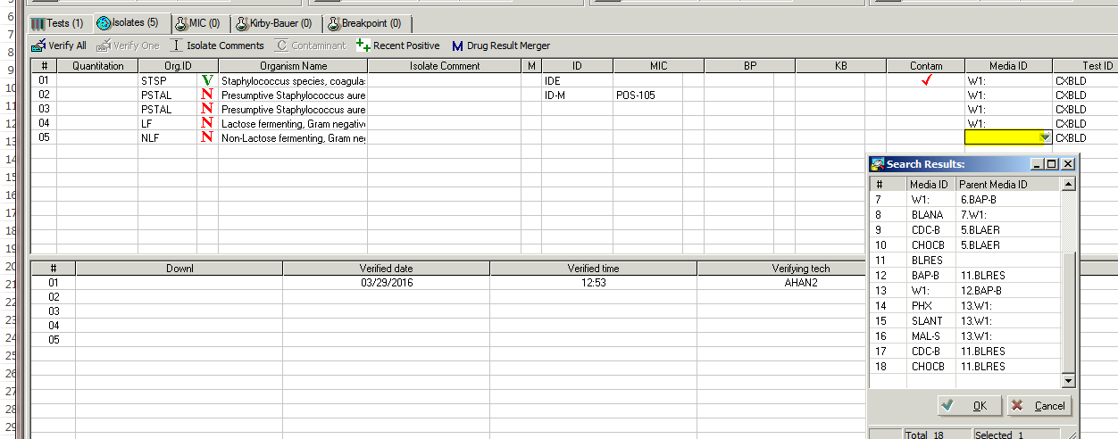

Slide 20
In order to qualify as a POSITIVE for either being considered a contaminant OR a true positive for the BCC report, the organism needs to be reflexed from the following:
Blood Culture media (which has the flag checked in set up) or….
a child media of the Blood culture media, and…
The media from which it is reflexed or its parent media must be marked as resulted which sets the Resulted Media Flag.

Slide 21
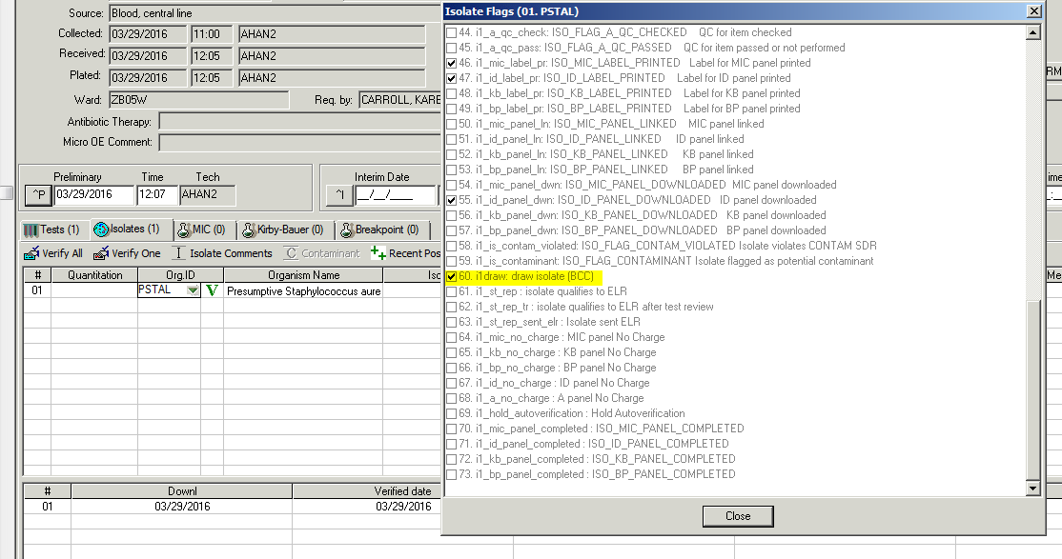
The isolate, if resulted correctly, will have the isolate flag 60 checked off which qualifies the isolate to the BCC report.

Slide 22
IF, you add an isolate manually in the Isolate tab, it will not be associated with Blood Culture Media and will NOT qualify to the report.

Slide 23
In order to have the system know which organisms you want flagged as potential contaminants, you need to set up an SDR rule.

Slide 24
When you result a potential contaminant, you will get the following pop up based on the rule that was written.

Slide 25
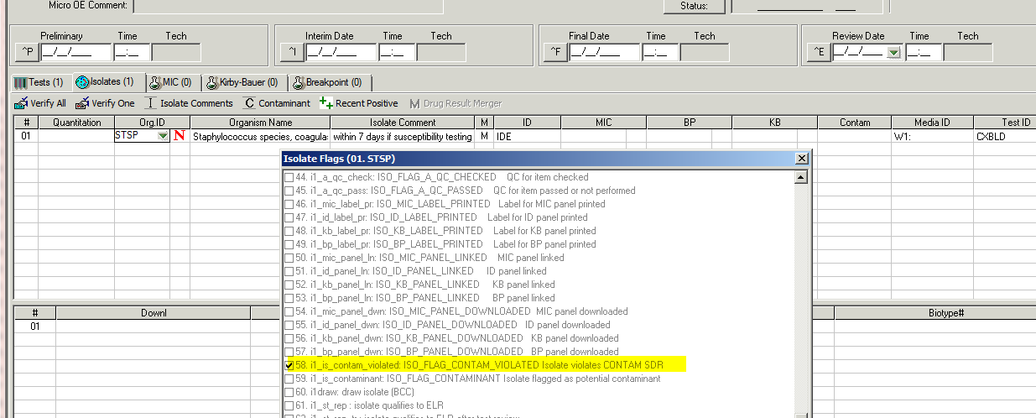
Saying NO to the RULE makes the isolate NOT a contaminant. Only Flag 58 is marked.

Slide 26
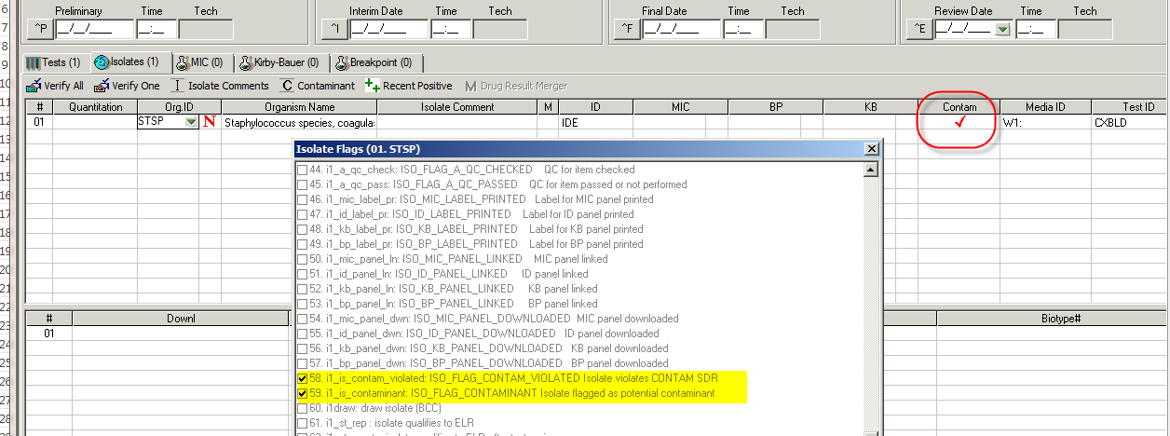
Saying YES to the rule, marks the organisms as a Contaminant. Isolate Flags 58 and 59 are both marked. Contaminant Column Checked off as well.

Slide 27
Changing the Contaminant flag:
Click on the Contaminant option when in the isolate tab. A comment box will open. Give the reason for removing the contaminant flag. Once you click ok, the flag is removed.

Slide 28
Summer Olympic Trivia #3
Where are the games to be held and what is the official motto of the 2016 games?

Slide 29
Location of the Summer Olympics!!
Rio de Janeiro, Brazil
This is the first time that the Olympics are being held in South America.
33 different Olympic Venues in four districts of Rio.
Total cost of Rio hosting the games is about 95 million US dollars!

Slide 30
Official Motto:
Live your Passion!

Slide 31
Blood Culture Contamination Report (Epidemiology Report)

Slide 32
Report type: Blood Culture Contamination

Slide 33
Epidemiology Tab:
BCC report is always based on Collection Date. Other reports give the option of tested date, but BCC does not.
In Additional Criteria section, for wards, choose IsoWard: The location where the order was placed. The report gives data based on location and you want the data to correlate with where the blood culture was collected.

Slide 34
Epidemiology Tab (cont):

Slide 35
BCC report layout is the default and will give you everything.
BCC_Raw_Data_spreadsheet: this will give you the raw data in spreadsheet form allowing you to see each order and who is marked as the person who obtained the specimen.

Slide 36
Micro Criteria Tab:

Slide 37
Micro Criteria Tab:
You have the option to pull the report based on the system marking an organism as a contaminant OR the user marking the organism as a contaminant based on the rule firing.

Slide 38
Summer Olympic Trivia #4
Who is the swimmer from Baltimore, Maryland who is coming out of retirement to compete in the 2016 summer Olympics?

Slide 39
Michael Phelps!
Most decorated Olympian of all time: 22 medals (18 of them gold!)

Slide 40
Interpreting the report!

Slide 41
First Page of the report:

Slide 42
First section: Contamination Rate
This section of the report is one that I tend to skip through. It has a lot of information, but it is better organized later in the report.
Each location from which a Blood culture was drawn has data on this report.

Slide 43
Draw Frequency
Draw frequency refers to the number of blood cultures that were drawn for the same person within a 24 hour period. Our goal is to decrease the percentage of draw frequencies that fall in the 1x category.
****NOTE: This section of the report pulls the CORRECT draw frequency numbers. Other areas of this report do NOT pull the correct draw frequency numbers.

Slide 44
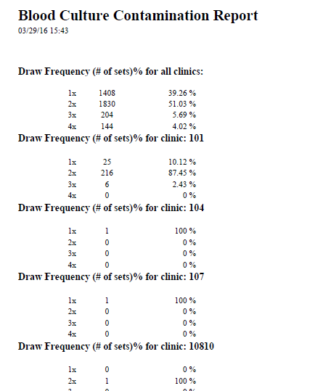

Slide 45
Contamination by clinic
This is the section that we use routinely to report to the areas in the hospital that we monitor.
***NOTE: The DF(1X) in this section is incorrect. Do not use this data.

Slide 46
Contamination by clinic(Cont.)
Draws(#) is the total number of blood cultures drawn from the particular unit during the time noted in the report.
Positive (%#) is the Positivity rate and the number of cultures that were marked as positive. This number includes the ones that have contaminants.
BCC (%#) is the Blood culture contamination rate and the total number of cultures that are marked as having contaminants.

Slide 47
Contamination by collector:
This section can be used to monitor those that are collecting the blood cultures. If you see an increase from a particular person, education can be implemented to bring down the contamination numbers.

Slide 48
Highlighting high Contamination rates:
Notice that the ones that have a contamination rate higher than what you set up in SSM will be highlighted Yellow.

Slide 49
Raw Data Section:

Slide 50
Raw Data Section:
For Raw data, you are better off pulling a separate report for just the raw data by changing the Report layout to BCC_Raw_Data_spreadsheet.
This report prints out the raw data in an excel file so you can export it easily.

Slide 51
So….
Are you Brave enough??

Slide 52
To go to the Summer Olympics???

Slide 53
…and….
are you brave enough…

Slide 54
To start using this report?
ISSUES:
The report is fine except the Draw Frequency value anywhere except the Draw Frequency Section of the report.
Your set up and workflow have to allow for proper flagging.
Soft has had issues both last year and this year where the flagging of cultures is not happening correctly causing the data to be incorrect when pulling the report.

Slide 55
QUESTIONS?

